Slide 1


Slide 2

Virtual University Campus Event Management System (VUCEMS)
CS519
Associate Degree Program (ADP)

Slide 3
Introduction
Name: MAZHAR JAVED
VU ID: BC230401227
Supervisor Name : Hafiz Muhammad Azeem Sarwar

Slide 4

INTRODUCTION OF PROJECT
The Virtual University Campus Event Management System (VUCEMS) is a web-based application designed to make managing university events easy and organized. It provides a central platform for students, faculty, and administrators to interact with events such as webinars, workshops, seminars, and cultural programs. Faculty and staff can create, update, and manage events, while students can view, search, and register for them. The system also handles notifications, event feedback, and reporting. By automating these processes, VUCEMS improves event visibility, encourages student participation, and reduces manual work in event coordination at the Virtual University of Pakistan.

Slide 5
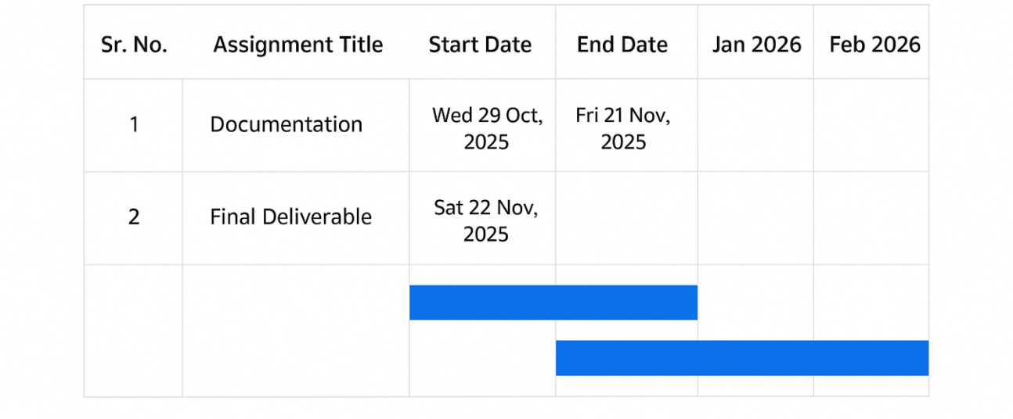
Project Schedule

Slide 6
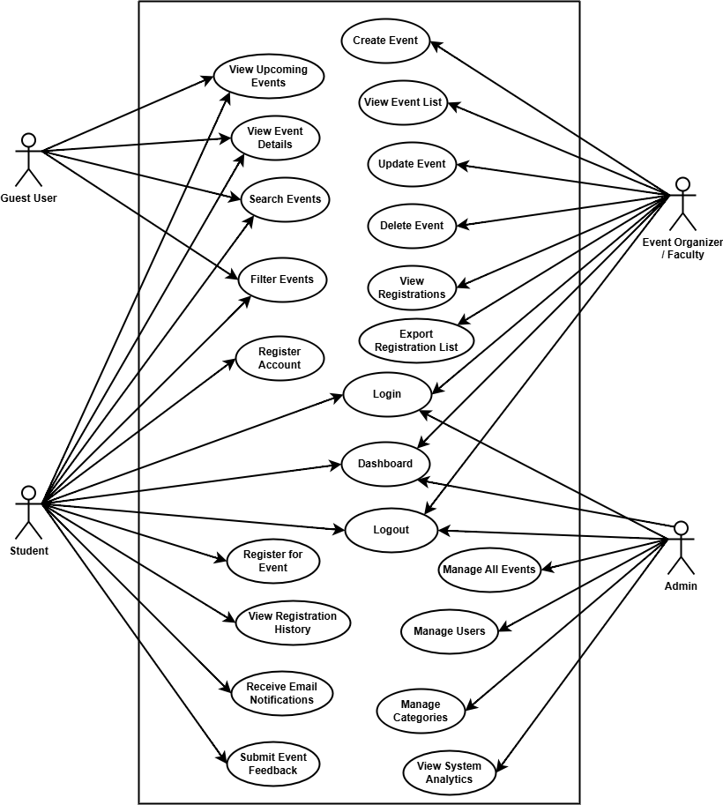
Use Case Diagram

Slide 7
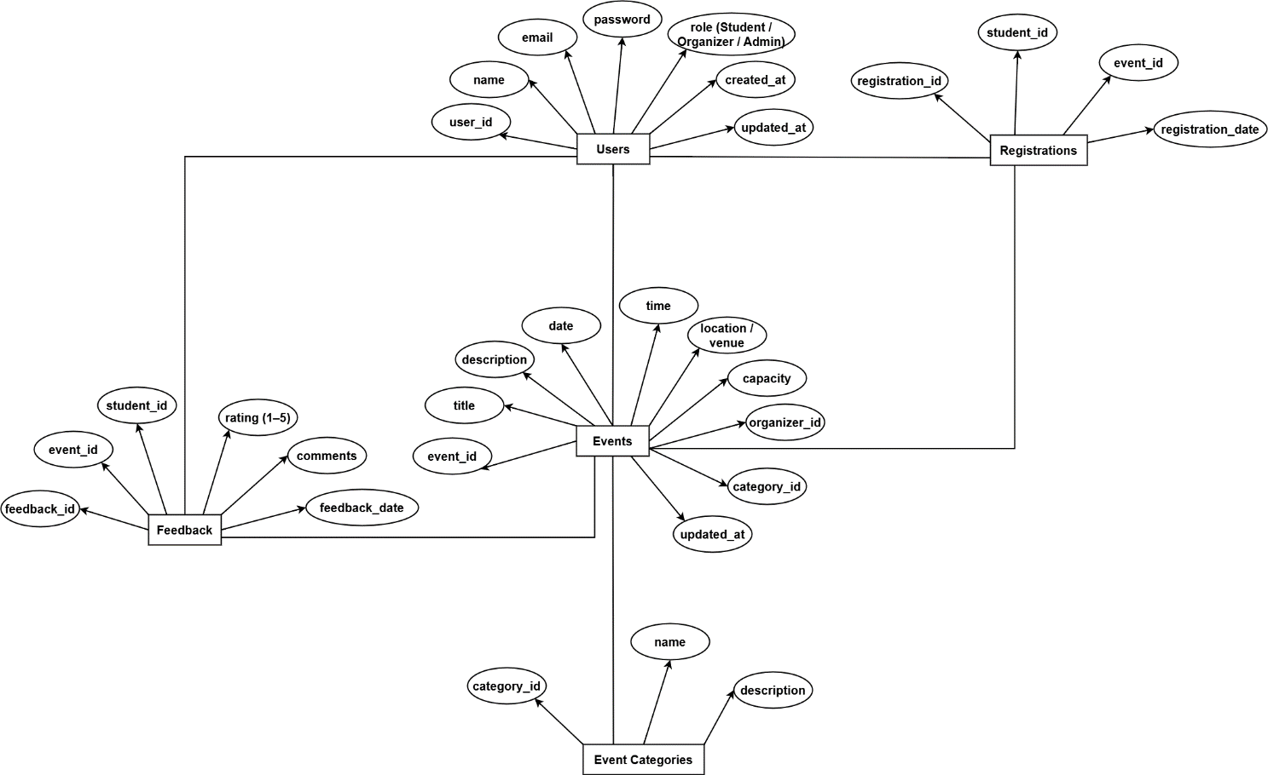
Entity-Relationship Diagram

Slide 8
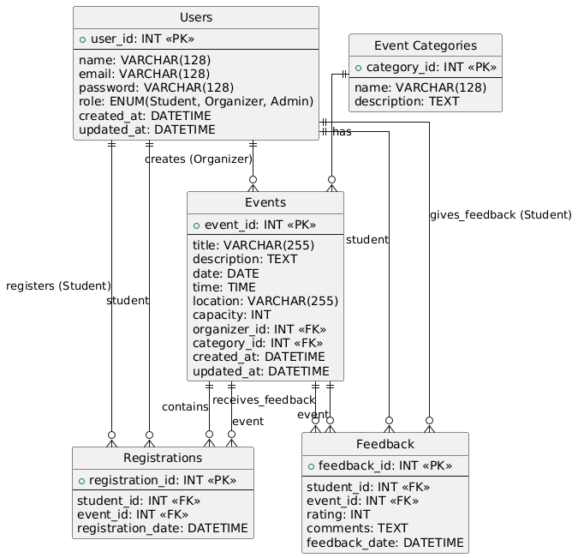
Relational Schema

Slide 9
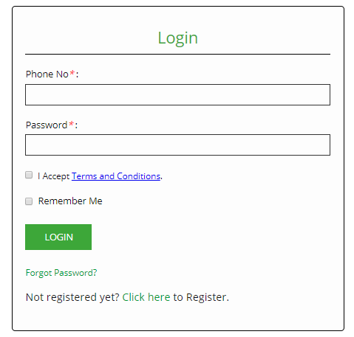
User Interfaces

Slide 10
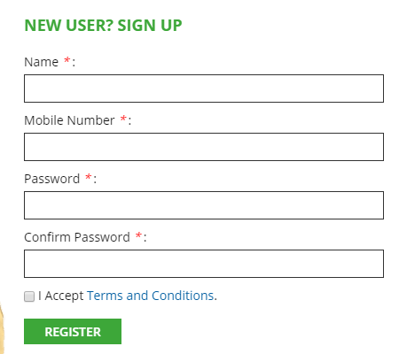
User Interfaces

Slide 11
Results

Slide 12
Tools
Xampp
Sublime
Chrome

Slide 13
Thank you

